Slide 1


Slide 2

POSTER

Slide 3
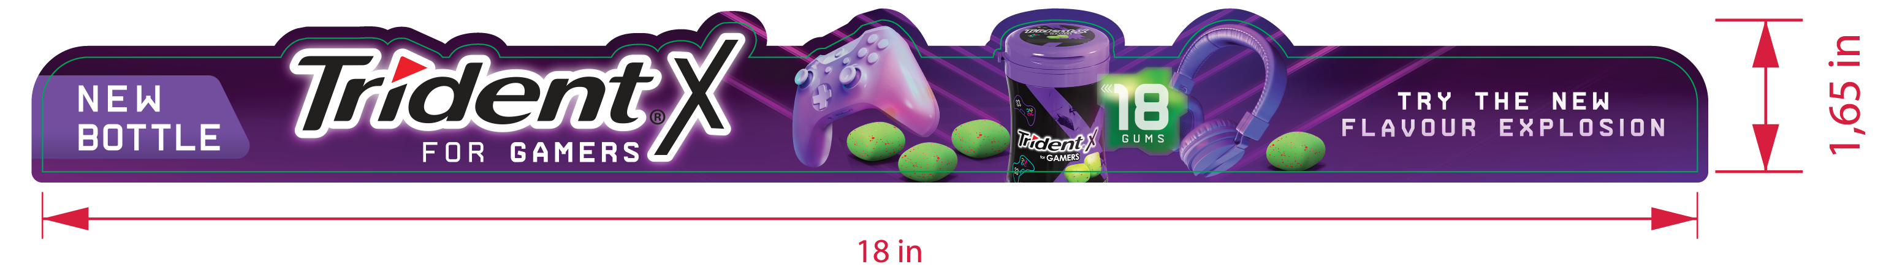
SHELFSTRIP

Slide 4

WOBBLER

Slide 5

PRICE TALKER

Slide 6
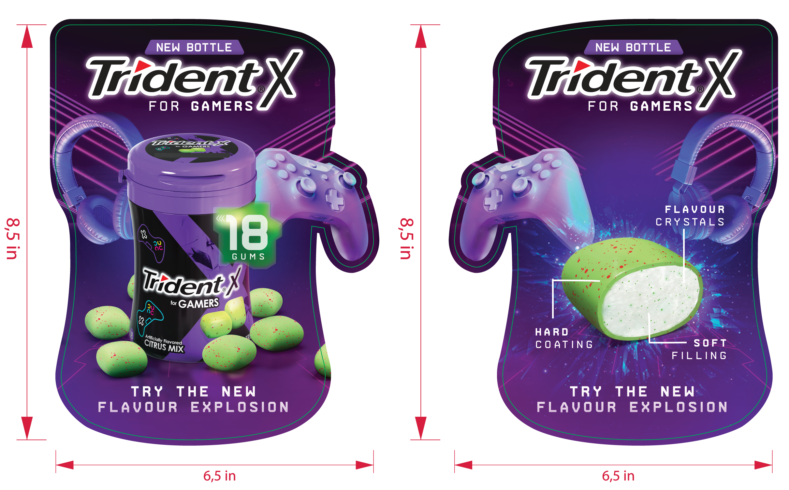
STOPPER

Slide 7

WING

Slide 8

SIDE PANEL

Slide 9


POST AD
Vers. 1
Vers. 2

