Slide 1

POSTER

Slide 2
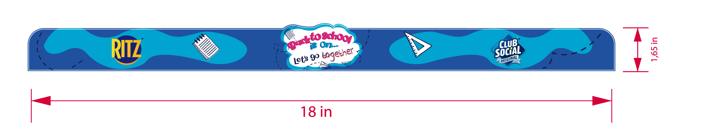
CENEFA

Slide 3
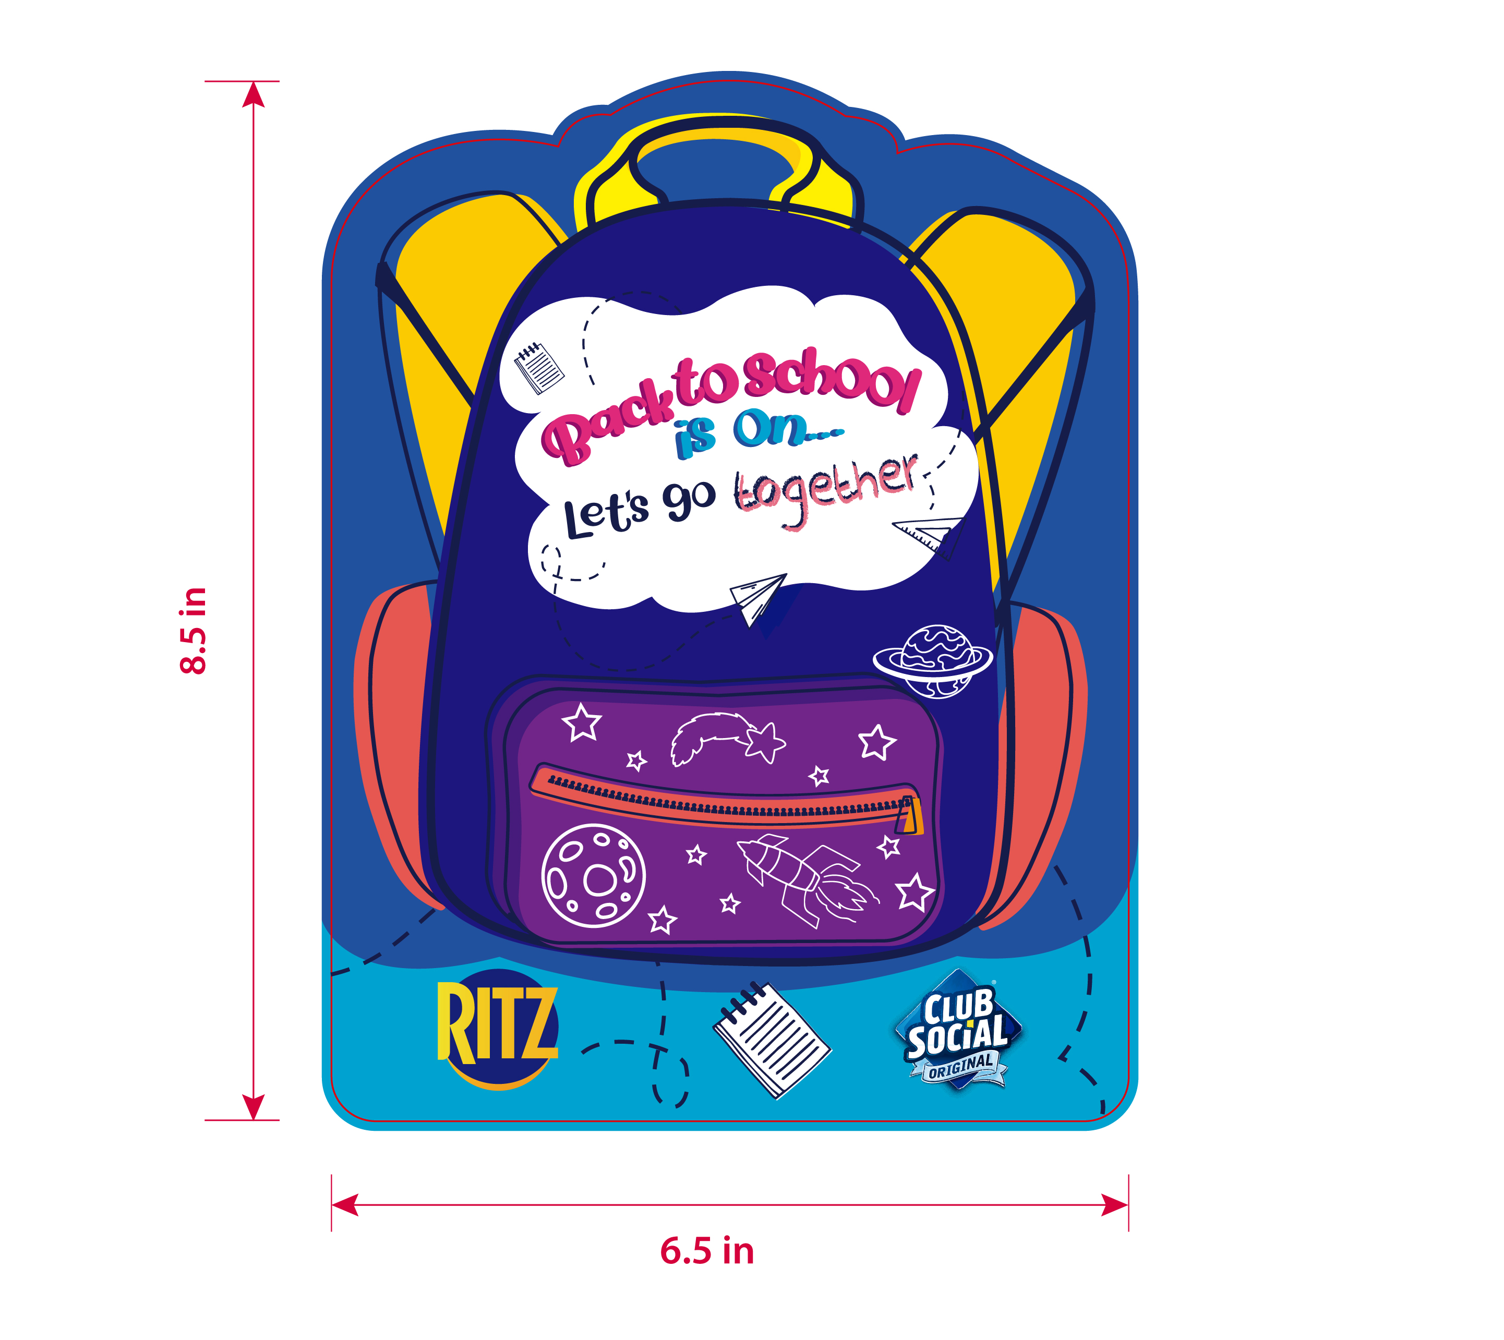
STOPPER

Slide 4
END CAP

Slide 5
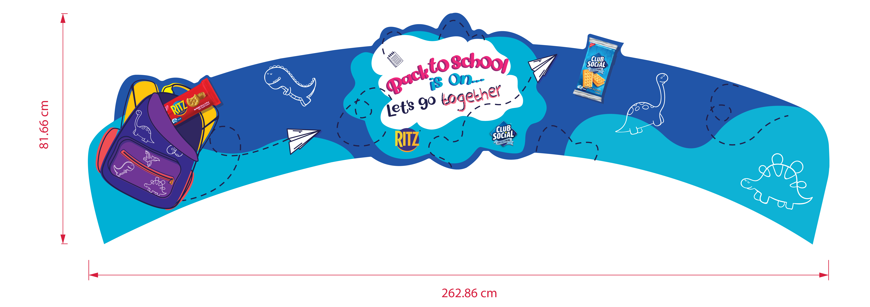
ARCO

Slide 6

FLOORSTICKER

Slide 7
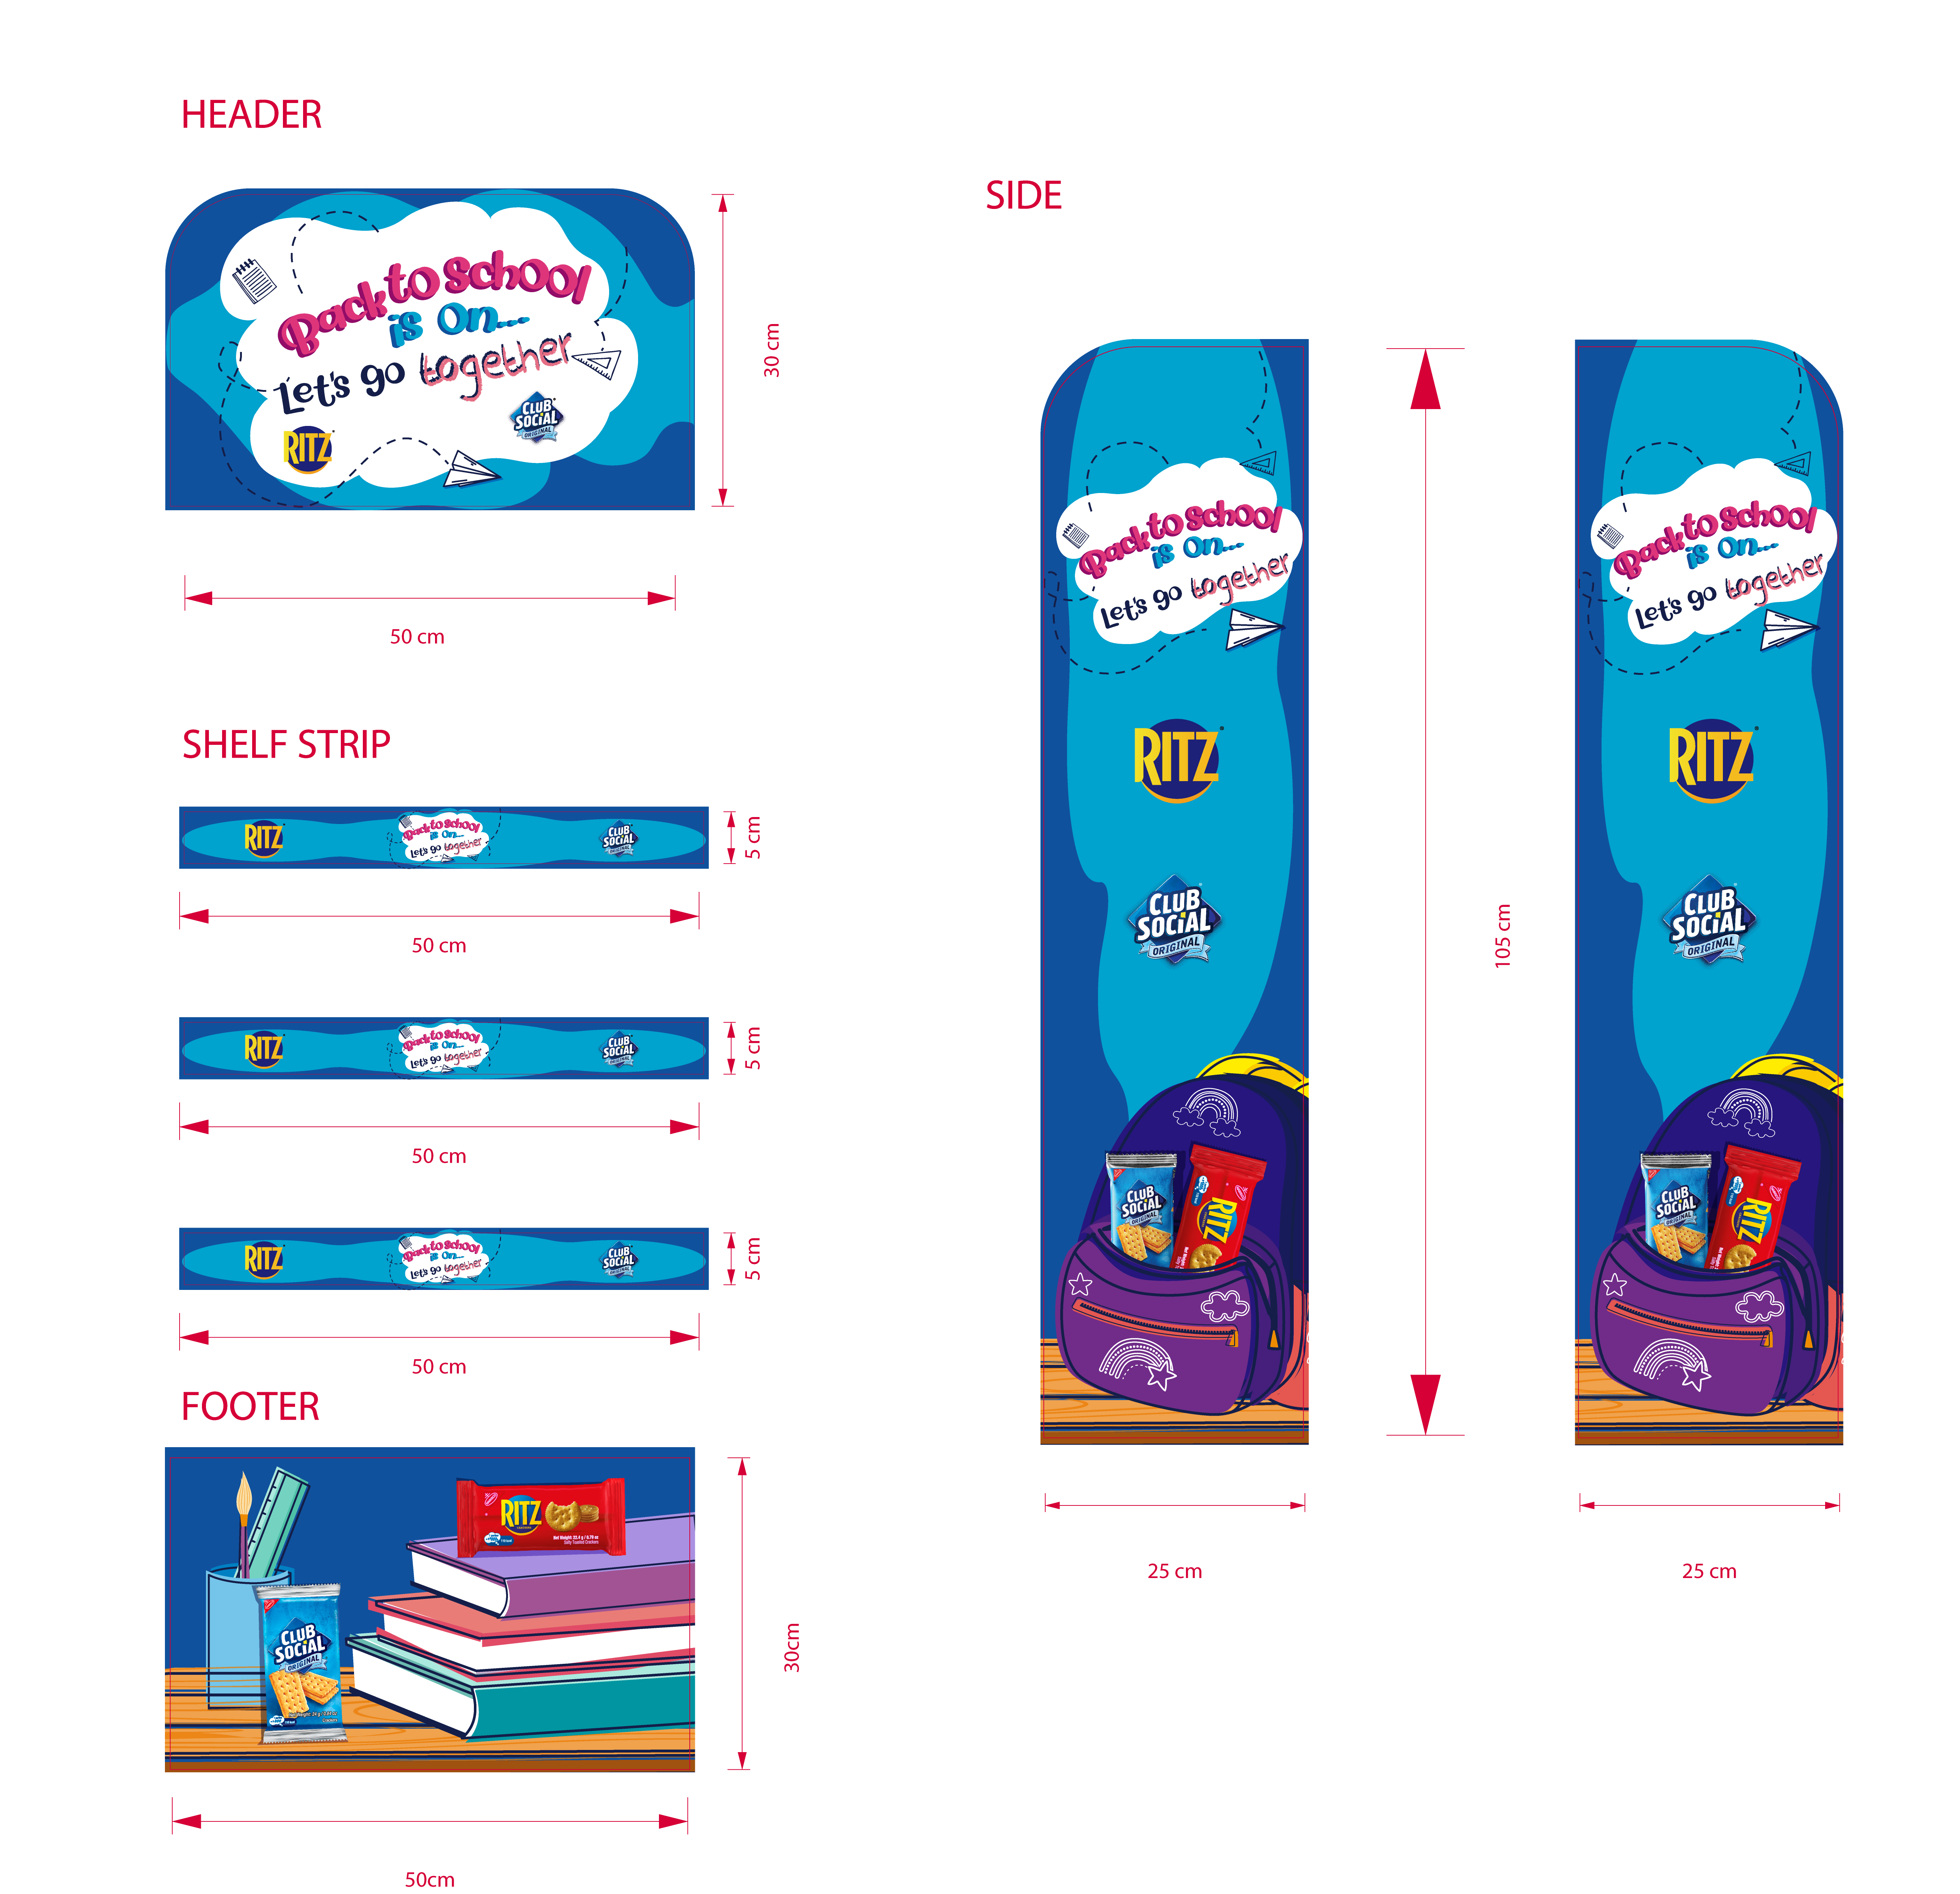
MOJITO

Slide 8
MOJITO TEMPORAL

Slide 9
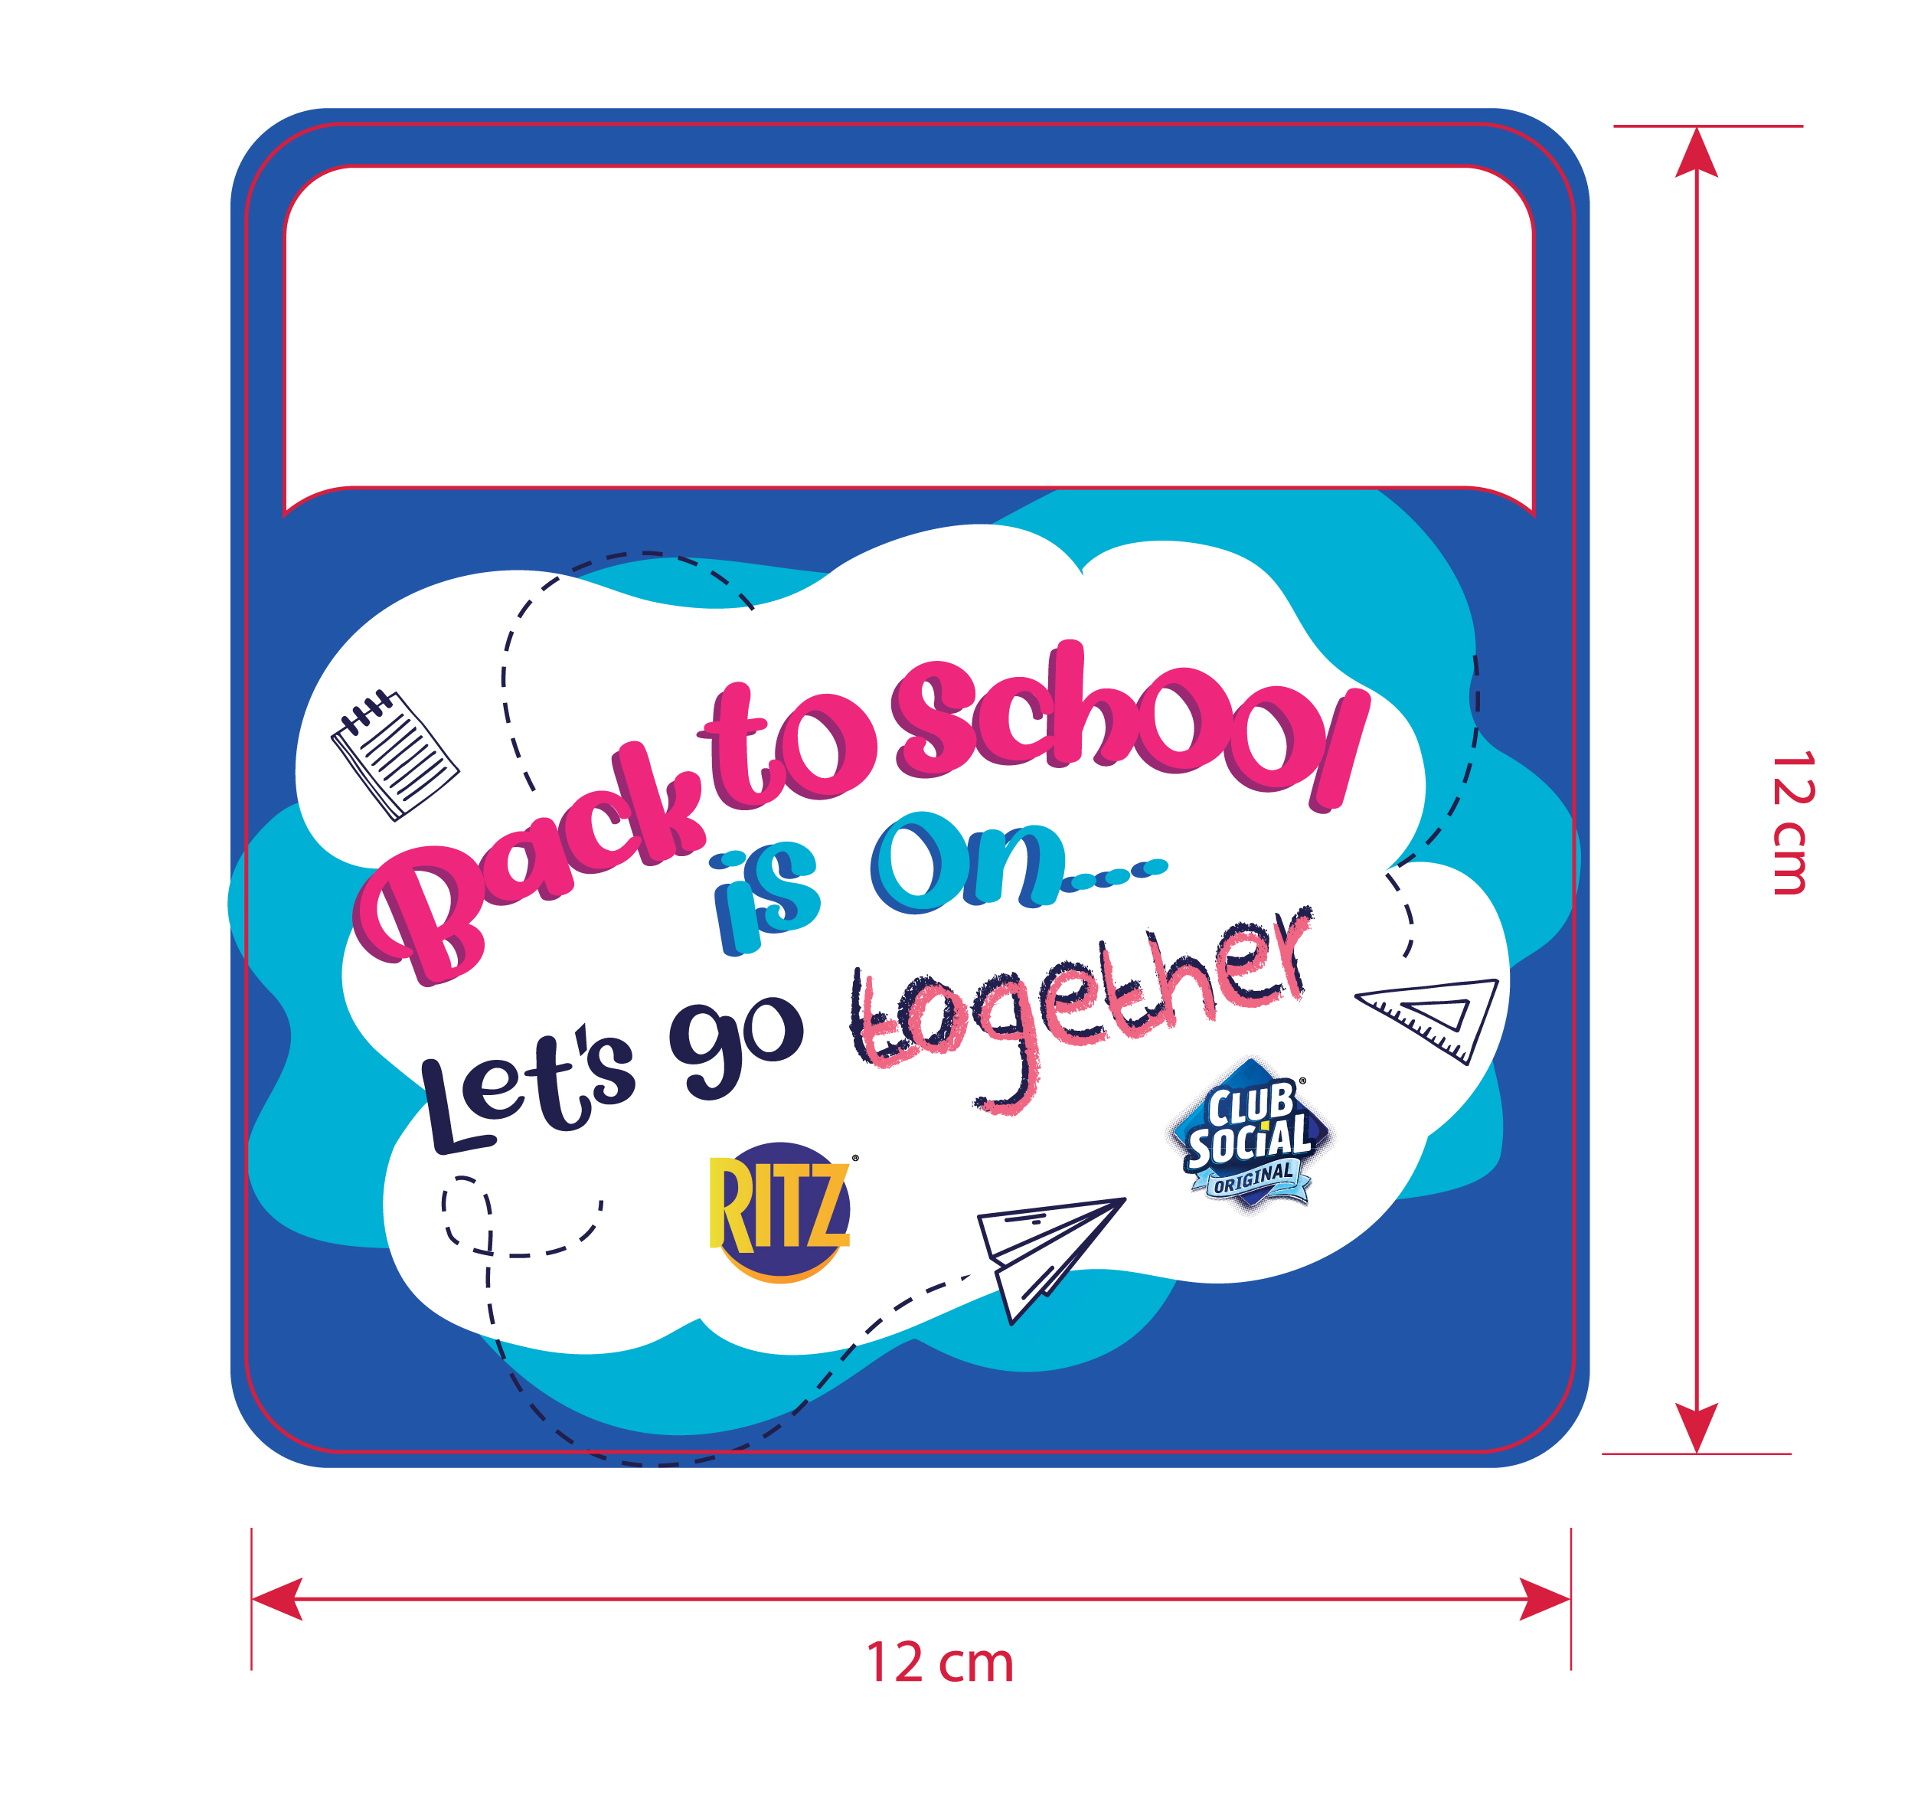
PRICETALKER

Slide 10
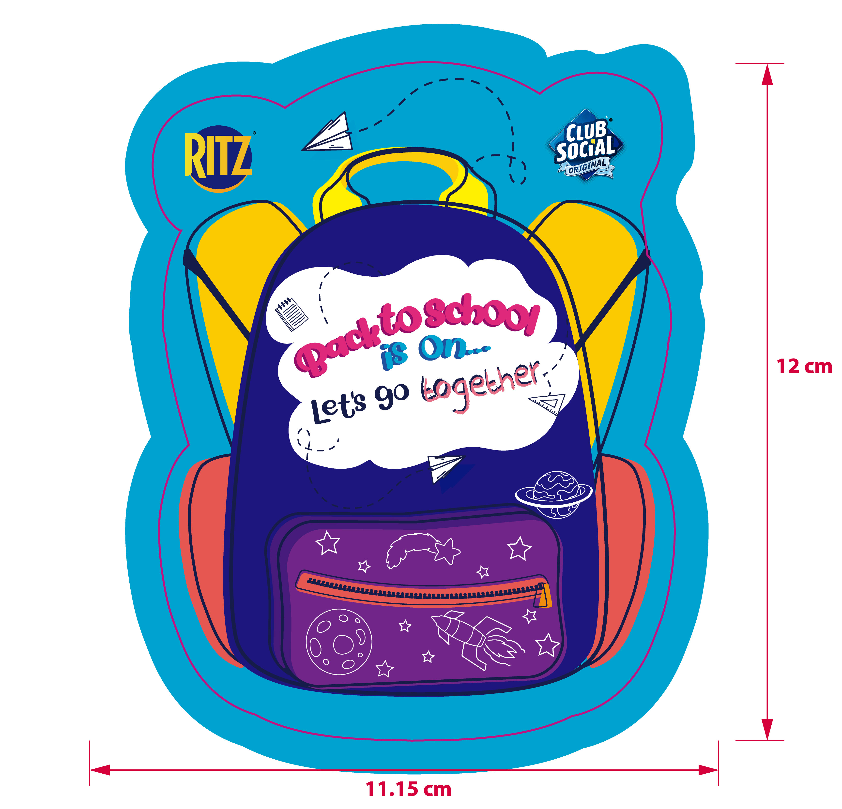
DANGLER

Slide 11
TDC

